Slide 1
AIRCRAFT STABILITY

Slide 2
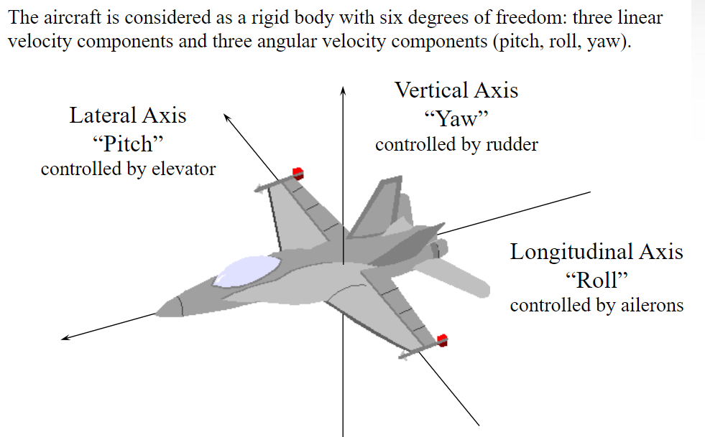
Degree of Freedom of Aircraft Motion:

Slide 3
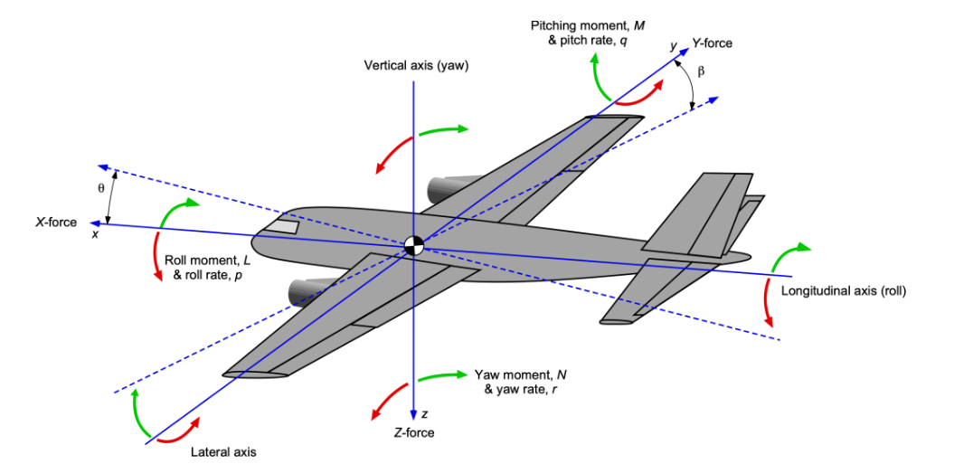
Degree of Freedom of Aircraft Motion:

Slide 4
Equations of Motion:
To study the performance of an airplane, First, establish the fundamental equations that govern its translational motion through the air.
Consider an airplane in flight.
The flight path (direction of motion of the airplane) is inclined at an angle θ with respect to the horizontal.
The flight path direction and the relative wind are along the same line. The mean chord line is at a geometric angle of attack α with respect to the flight path direction.
Four physical forces are acting on the airplane:
1. Lift L, which is perpendicular to the flight path direction.
2. Drag D, which is parallel to the flight path direction.
3. Weight W, which acts vertically toward the center of the earth (and hence
is inclined at angle θ with respect to the lift direction).
4. Thrust T, which in general is inclined at the angle α T with respect to the flight path direction.

Slide 5
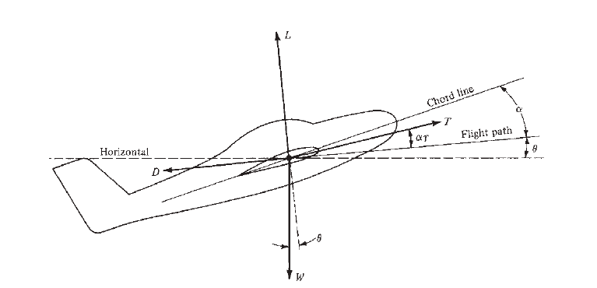
Equations of Motion:
Force diagram for an airplane in flight

Slide 6


Equations of Motion:
When an object moves along a curved path, the motion is called curvilinear, as opposed to motion along a straight line, which is rectilinear. Newton’s second law, which is a physical statement that force = mass × acceleration, holds in either case.
Consider a curvilinear path. At a given point on the path, set up two mutually perpendicular axes, one along the direction of the flight path and the other normal to the flight path. Applying Newton’s law along the flight path gives
where Σ F || is the summation of all forces parallel to the flight path
where Σ F ⊥ is the summation of all forces perpendicular to the flight path and
V² / r_{c} is the acceleration normal to a curved path with a radius of curvature r_{c} .

Slide 7


Equations of Motion:
Examining Figure, we see that the forces parallel to the flight path (positive to the right, negative to the left) are:
and the forces perpendicular to the flight path (positive upward and negative downward) are:

Slide 8
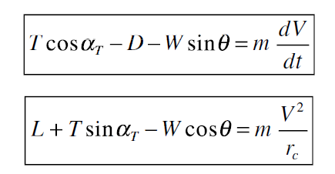
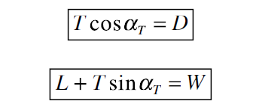
Equations of Motion:
Combining the above equations yields :
These Equations are the equations of motion for an airplane in translational flight.
Consider level, unaccelerated flight. Referring to Figure, level flight means that the flight path is along the horizontal; that is, θ = 0.
Unaccelerated flight means that the right sides of Equations are zero.
Therefore, these equations are reduced to:

Slide 9
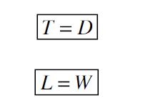
Equations of Motion:
For most conventional airplanes, α_{T} is small enough that cos α_{T} ≈ 1 and sin α_{T} ≈ 0.
Thus, from Equations:
Equations of motion for level, unaccelerated flight.

Slide 10
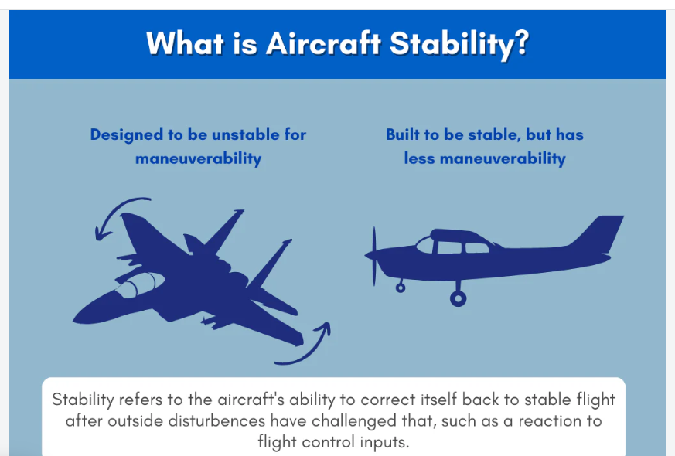
Aircraft Stability:
"The characteristic of an aircraft that causes it to return to its original flight condition after it has been disturbed."

Slide 11
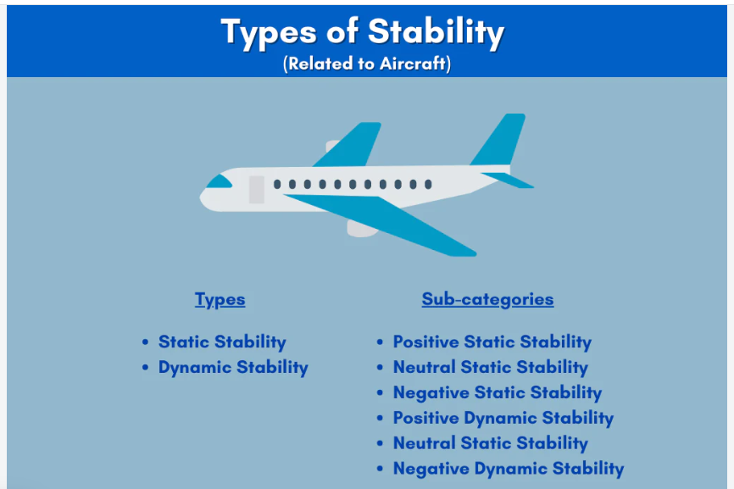
Aircraft Stability:

Slide 12
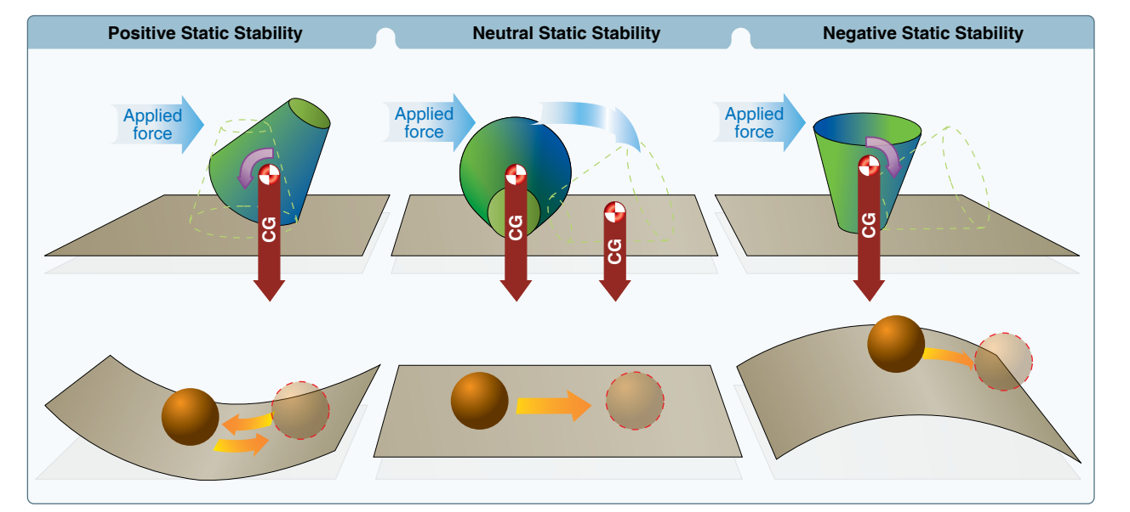
Aircraft Stability:

Slide 13
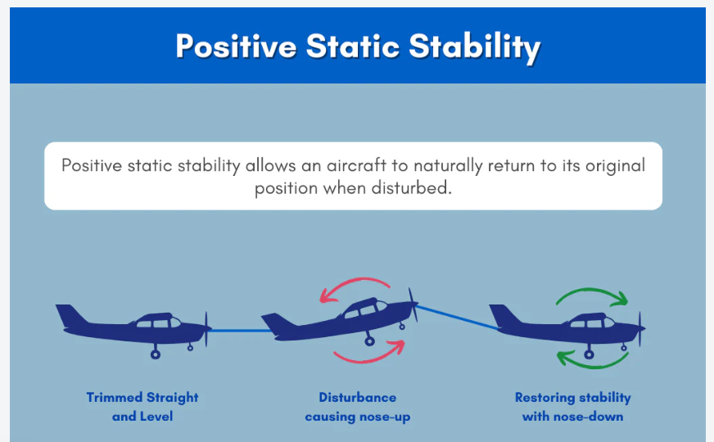
Aircraft Stability:

Slide 14
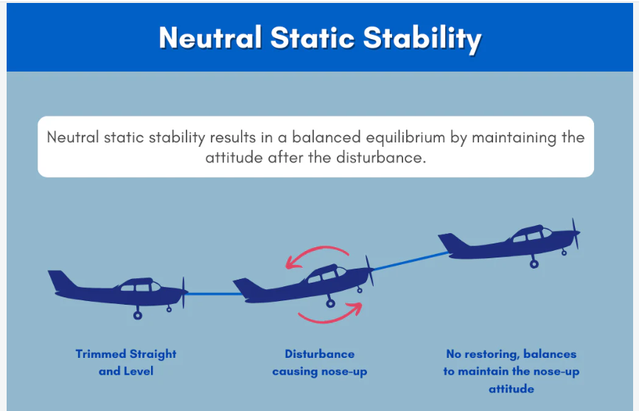
Aircraft Stability:

Slide 15
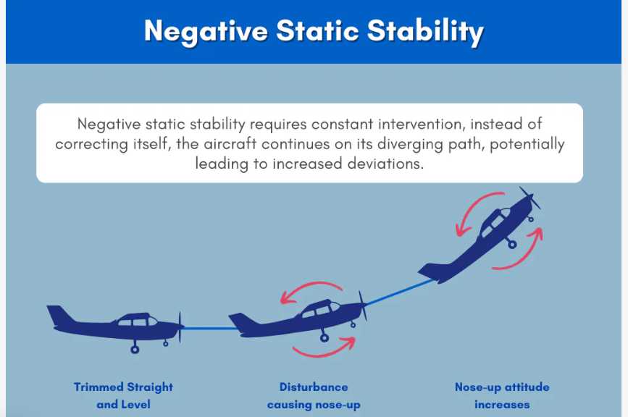
Aircraft Stability:

Slide 16
Aircraft Stability:
"When an aircraft is disturbed from the straight and level flight, its static stability starts it back in the correct direction; but it overshoots, and the corrective forces are applied in the opposite direction.
The aircraft oscillates back and forth on both sides of the correct condition, with each oscillation smaller than the one before it. Dynamic stability is the decreasing of these restorative oscillations."

Slide 17
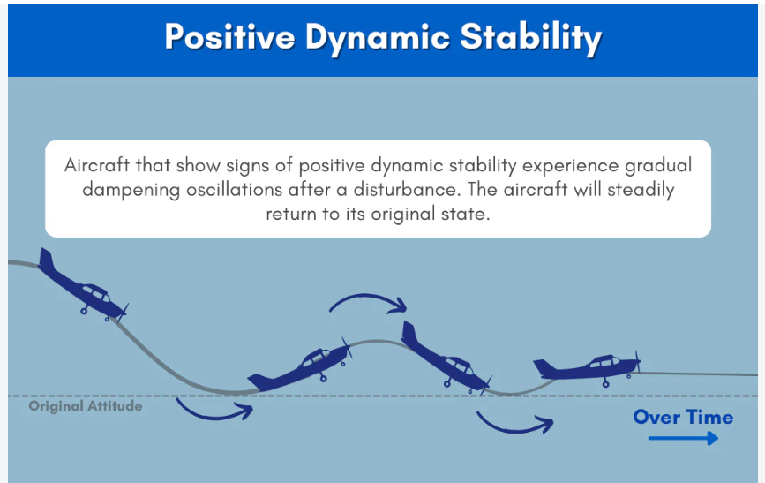
Aircraft Stability:

Slide 18
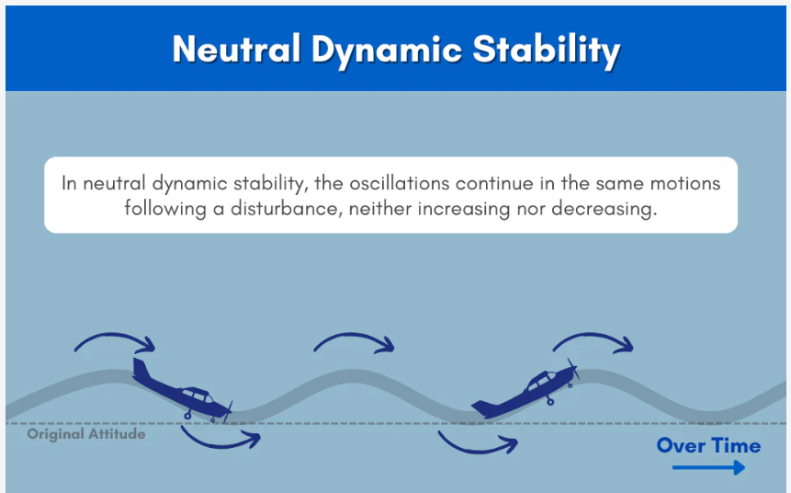
Aircraft Stability:

Slide 19
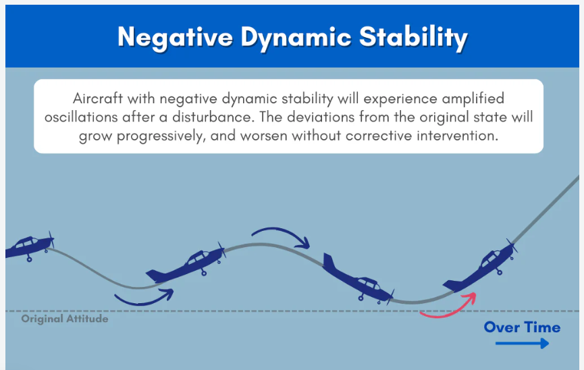
Aircraft Stability:

Slide 20
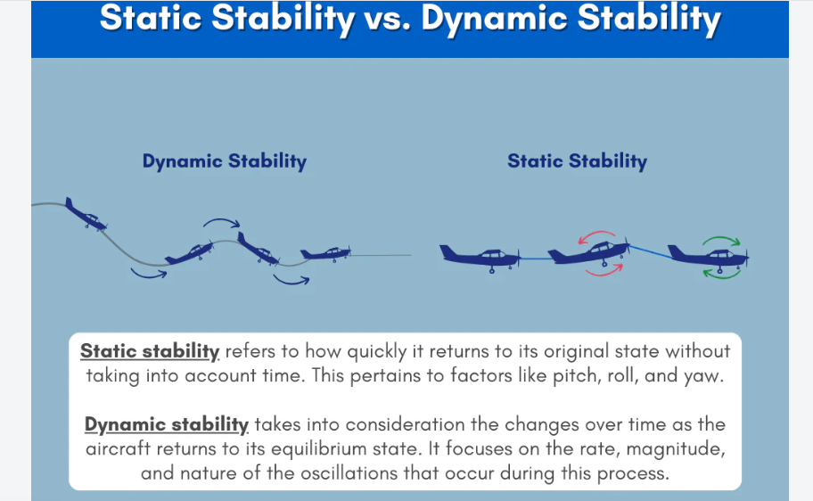
Aircraft Stability:

Slide 21







Slide 22
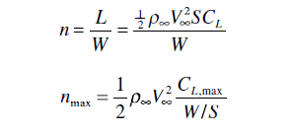

Slide 23
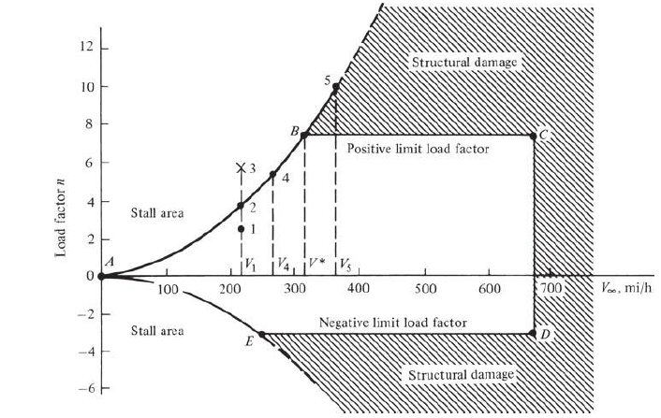
Structural Failure
Structural Failure
V-n diagram for a typical jet trainer aircraft

Slide 24






